Slide 1
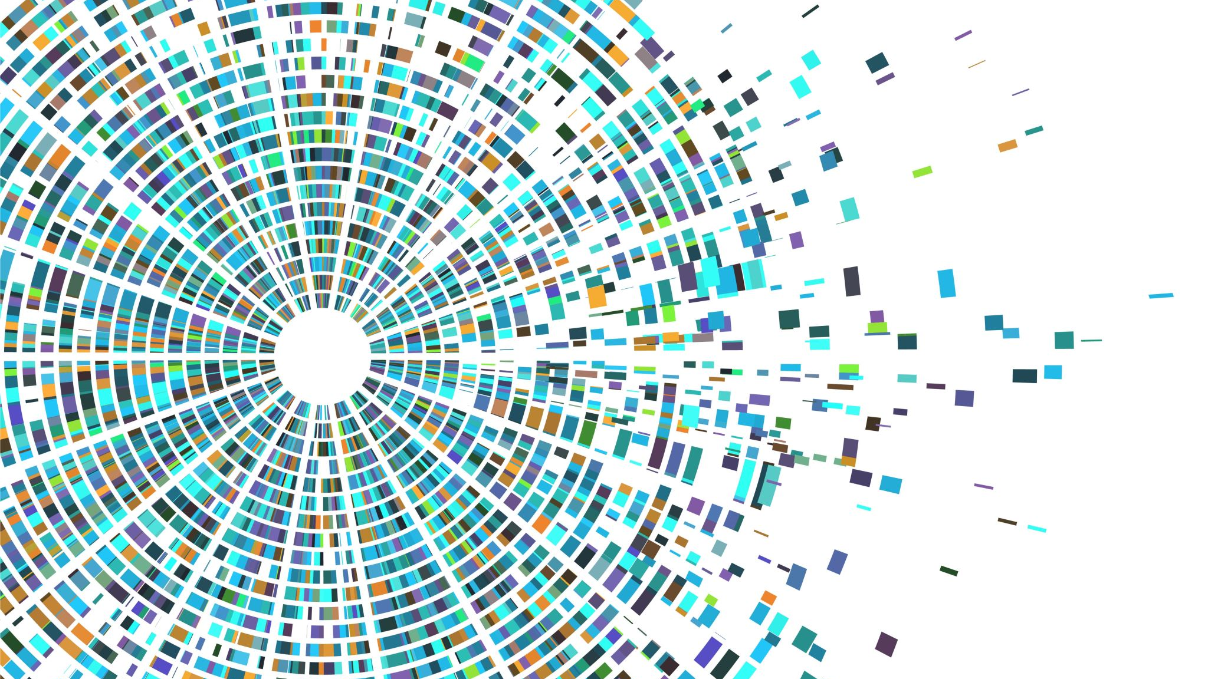
Neural Style Transfer using Convolutional Neural Networks
Team Members:
Sai Kaushik Surampudi Saketh Gondela Manvitha Kancharla Pradyumna Poralla Deepthi Padmasree Gollamudi

Slide 2

ABSTRACT
One of the most popular and widely used methods of neural networks in the AI world is neural net image styling. This method has been gaining wide range popularity among the industry.
This algorithm is used by most of the top social media sites to develop their applications, which allow users to apply different filters to their images and customize their picture styling.
We would be dealing with the job of neural picture styling in this project. The basic objective is to combine a style picture with content images to generate a style image. In order to do this, we deploy the VGG-19 model architecture

Slide 3

DATASET
The dataset is a collection of the top works produced by 50 of history's most important artists. The artist.csv file, which contains details about the artists and their works, is one of the three main files in this dataset.
This excel document essentially provides all information regarding the details of each artist. Additionally, there are two main folders: resized.zip and image.zip.
The photos required to finish our project are located in these two files. The resized folder contains the same collection of photographs as the image.zip, but the images in this folder have been resized and are numbered in order.

Slide 4
Proposed Methodology
Import Dataset from Kaggle. We need to preprocess our data.
We work on images of our dataset and to make them accessible we resize these images and process them accordingly.
A pre-trained method is required for style transfer so we use TensorFlow model called ImageNet-VGG “VGG-19”.
As result the model work as feature extractor between the layers and deliver output.

Slide 5
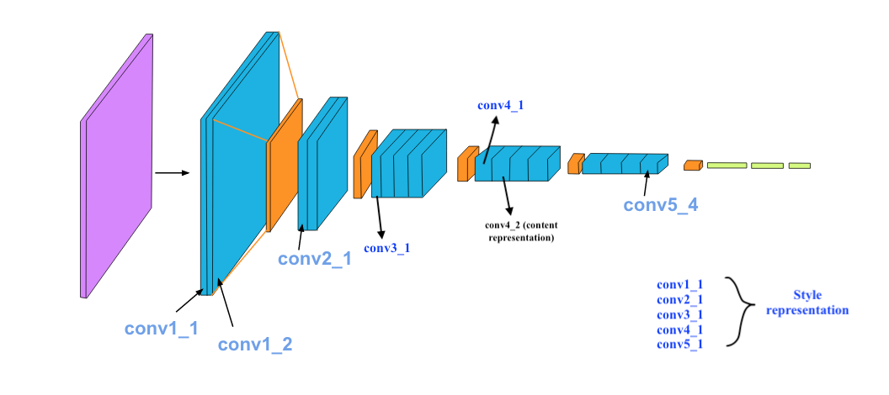
VGG-19
Out of all the networks, VGG19 gave us the best performance metrics. It is one of the most widely used network for image related tasks. It is designed in such a way that it helps processing the image faster. It was trained on the google ImageNet Database.
VGG 19 is a variant of the VGG model that consists of 19 layers in total. In this 16 layers are convolutional layers, 3 are fully connected layers, 5 are the max pooling layers and contains 1 softmax activation layer.
There are 1 thousand layers make up output layer which represents 1000 potential classes in ImageNet with 4096 neurons in first two layers.

Slide 6
Methodology
Neural style transfer is a technique for transferring a certain look from one picture to another while preserving the original image information.
The only modification is the way the image is styled to give it a more artistic feel. The layout or drawing is depicted in the content image, and the colors or painting used to represent the style are used.
It is a computer vision application involving CNN model and image processing methods. Let's now examine how NST functions.
For style transfer to work, neurons must be activated in a specific way, resulting in an output image and content image that are particularly similar in terms of content, while the design image and the output values image should be similar in terms of texture and capture the same ultimately present in the feature map. In a single loss formula, these two goals are merged, and we may choose how much we value both style reconstruction and content reconstruction.

Slide 7
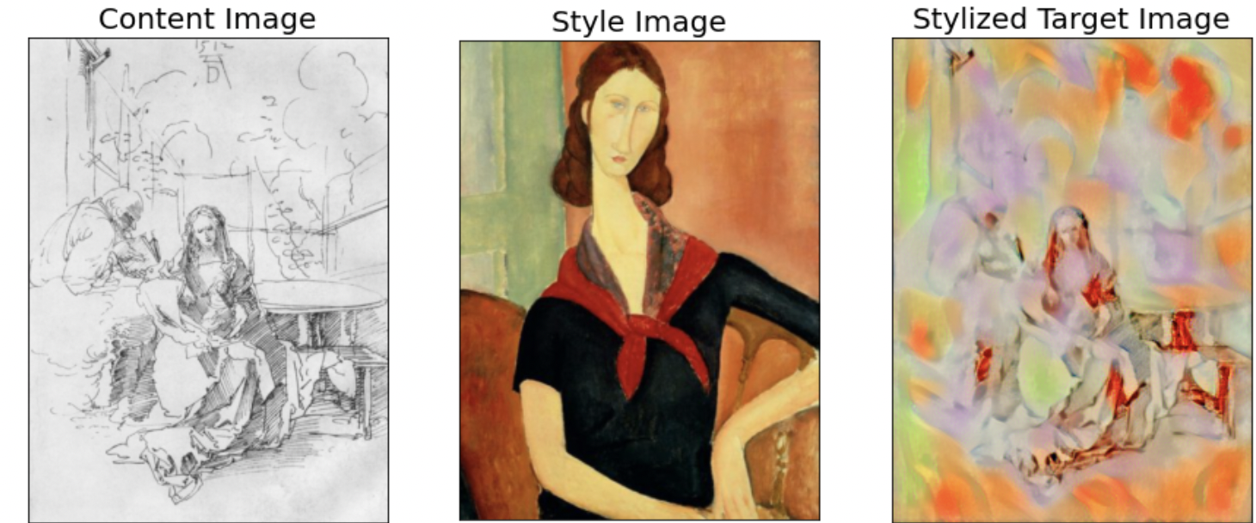
RESULTS
Below image shows the final output of the project and shows how the style has been transferred to the content image.

Slide 8
CONCLUSION
This project has a lot of scope and applications in the real world artificial intelligence industry. In this project, we explore the concept of style transfer and how it works. We can already see its applications in our day-day activities such as our phone photos filters, Snapchat filters and other similar activities.
There is something particularly attractive about neural style transfer due to its ability to generate new picture patterns based on the original images. To do this, it could be necessary to promote proper CNN factorizations

Slide 9


